Slide 1
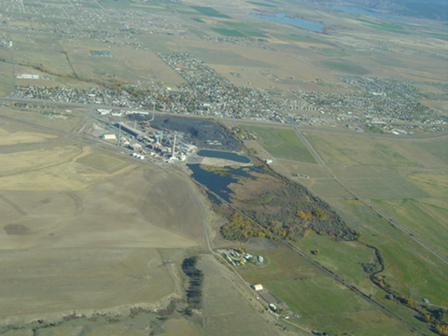
Update to the Soil Displacement Regulation
East Helena Superfund Site
Lead Education and Assistance Program
Beth Norberg
May 23, 2024

Slide 2
What is a Superfund Site?
CERCLA: Comprehensive Environmental Response, Compensation, and Liability Act
Informally called Superfund.
Allows EPA to clean up contaminated sites.
Forces the parties responsible for the contamination to either perform cleanups or reimburse the government for EPA-led cleanup work.
When there is no viable responsible party, Superfund gives EPA the funds and authority to clean up contaminated sites.

Slide 3
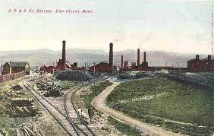
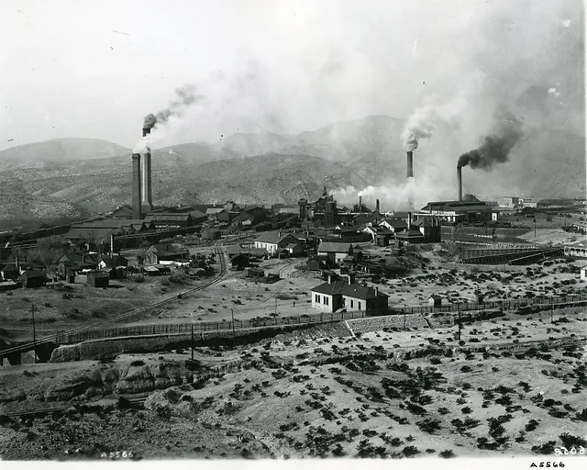
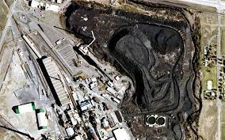
History of Site
140-acre ASARCO Lead and Zinc Smelter operated for over 100 years
Areal deposition of lead, arsenic and other heavy metals
Soil and water contamination

Slide 4
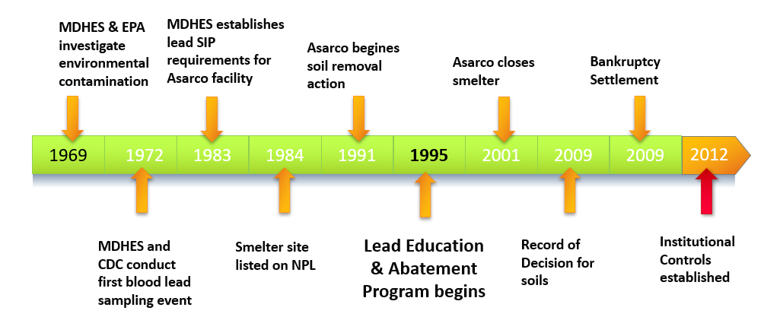
Public Health and Industrial Activity Timelines
Residential yard cleanup in the 1990’s and early 2000’s
Institutional Controls in place to prevent further contamination-2012.
Soils ordinance for displacement of soils in the IC Boundary

Slide 5
Lead Education and Assistance Program (LEAP)
Our Services:
Education and resources on lead-safe practices
Implement and administer institutional controls
Administer the Regulations Governing Soil Displacement and Disposal
Conduct residential environmental assessments
Provide information on the status of clean-up and sampling results

Slide 6
Board of Health Roles and Responsibilities MCA 50-2-116 (2) (c)(v)(A)
50-2-116 (2): Local boards of health may:
(c) propose for adoption by the local governing body regulations that do not conflict with 50-50-126 or rules adopted by the department:
(v) for the establishment of institutional controls that have been selected or approved by the:
(A) United States environmental protection agency as part of a remedy for a facility under the federal Comprehensive Environmental Response, Compensation, and Liability Act of 1980, 42 U.S.C. 9601, et seq.;

Slide 7
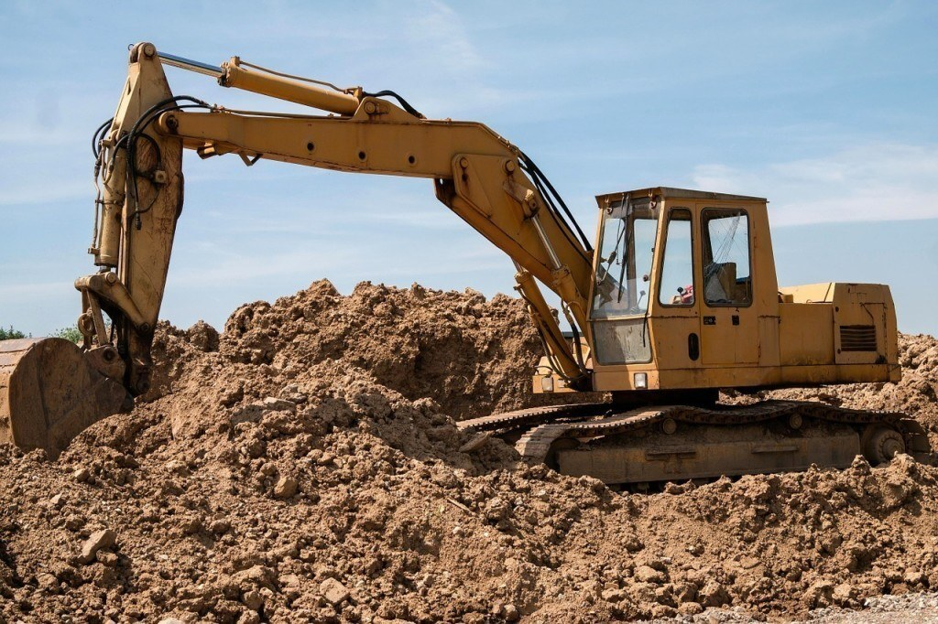
Soil Displacement Regulation
Original regulation adopted 2013
Permit may be required if disturbing more than 1 cubic yard of soil in the IC boundary
Requires certification of any person disturbing soil
Identifies lead and arsenic soil limits for displacement activities

Slide 8
Why the Change in Regulation?
Bioavailability in Lead
Not all lead is created equal
Not all lead present in soil is in a form that can harm humans or animals. Certain forms of lead are not fully available or absorbed by the human body. The amount that is absorbed is referred to as "bioavailable," meaning it is in a form that can enter the bloodstream and affect human health.
Explanation of Significant Differences defined bioavailability of lead in East Helena
50 residential lots sampled April 2023
Used the IUEBK Model (Integrated Exposure Uptake Biokinetic Model)
Determined relative bioavailability between 52.5% and 85% with a mean average of 64%
Lowered lead cleanup levels from 1,000 ppm to 400 ppm

Slide 9
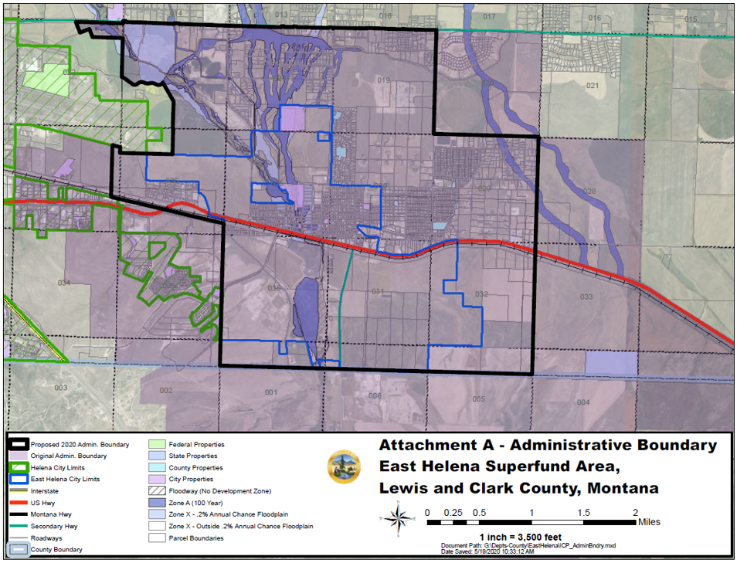
Proposed Changes to the Soil Displacement Regulations
Change requirement to obtain a soil displacement permit from 500 ppm to 400 ppm in soil for residential yards.
Changed replacement soil requirements from 100 ppm to 50 ppm lead in soil.

Slide 10
Proposed Changes to the Soil Displacement Regulations
Changed cleanup action level from 1000 ppm to 400 ppm lead in soil for:
residential properties,
Roads, alleys and Railroad Right of Ways,
Drainages, Floodplains and Irrigation Ditches.
Updated definitions

Slide 11
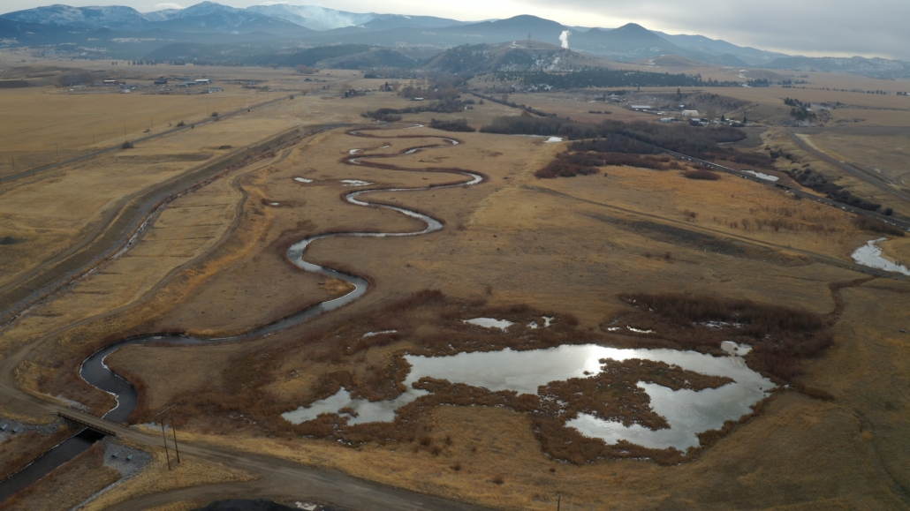
Next Steps
Open 30 Day Public Comment Period
Public Hearing at the June Board of Health Meeting
Board of Health votes to recommend for approval changes to regulation
Local Governing Body votes to approve changes to the regulation

Slide 12
Questions?

