Slide 1
Healthy Together Annual Progress Presentation
August 17, 2023
Presented by CHIP Priority Area Leads

Slide 2
Healthy Together Steering Committee
Amy Emmert, Director of Population Health, St. Peter's Health
Lori Ladas, Executive Director, Rocky Mountain Development Council, Inc.
Emily McVey, Executive Director, United Way of the Lewis and Clark Area
Drenda Niemann, Health Officer, Lewis and Clark Public Health
Justin Murgel, CEO, PureView Health Center
Haylie Wisemiller, Population Health, St. Peter's Health Julie Bir, Regional CONNECT Referral Coordinator, Lewis and Clark Public Health
Dorota Carpenedo, Epidemiologist, Lewis and Clark Public Health

Slide 3
Priority Area 1: Chronic Disease
Goal: Design culturally responsive policies, systems and environments in Lewis and Clark County for making the healthy choice the easy choice so that all community members can thrive in a culture that sustains health and prevents chronic disease.
Presented by:
Sarah Sandau

Slide 4
Successes
Year long process to create a thorough and meaningful Social Determinants of Health Accelerator Plan
Healthy Living Challenge
Farmers Market Bingo

Slide 5
Challenges/Barriers
Finding funding for implementation
Coalition capacity
Year 2 Next Steps
Implementation!

Slide 6
Priority Area 2: Behavioral Health
Goal: Create an environment in Lewis and Clark County in which the mental wellness of every resident is supported and all are empowered to live free from substance misuse or abuse.
Presented by:
Jess Hegstrom and Jolene Jennings

Slide 7
Behavioral Health Successes
988 Suicide Prevention and Mental Health Crisis Lifeline-Goal Surpassed!
Goal of 150 Behavioral Health Crisis Calls in first year expanded to 596!
Robust data collection and partnership collaboration.
Crisis System Dashboard developed for 3-Pillars
Multiple Provider and Public Health Collaboration
BH Crisis System Dashboard

Slide 8
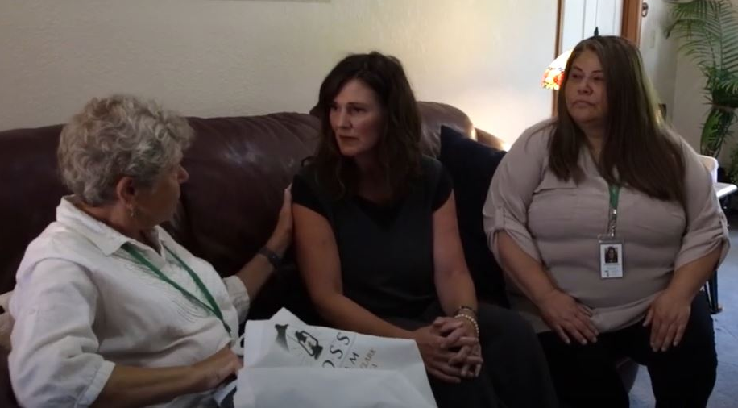
Behavioral Health Successes
755 people trained in suicide prevention, mental
health awareness in Q3 SAMHSA’s MHAT grant
48 suicide loss survivors received calls, resources,
and support since the start of LOSS Team of Lewis and Clark County Area
5 school districts supported by the Suicide Prevention Program are delivering the Signs of Suicide model to students

Slide 9
Behavioral Health Challenges/Barriers
No County funding provided for 988 outreach and promotion
Crisis Stabilization Facility slow to launch as 3rd Crisis Pillar
Lack of capacity at one school slowed progress of a Teen Mental Health First Aid pilot but is expected to continue in fall 2023
Staffing challenges has limited progress of suicide prevention program initiatives

Slide 10
Priority Area 3: Housing
Goal: Provide opportunities for residents of Lewis and Clark Area to access safe and affordable housing.
Presented by:
Jeff Buscher

Slide 11
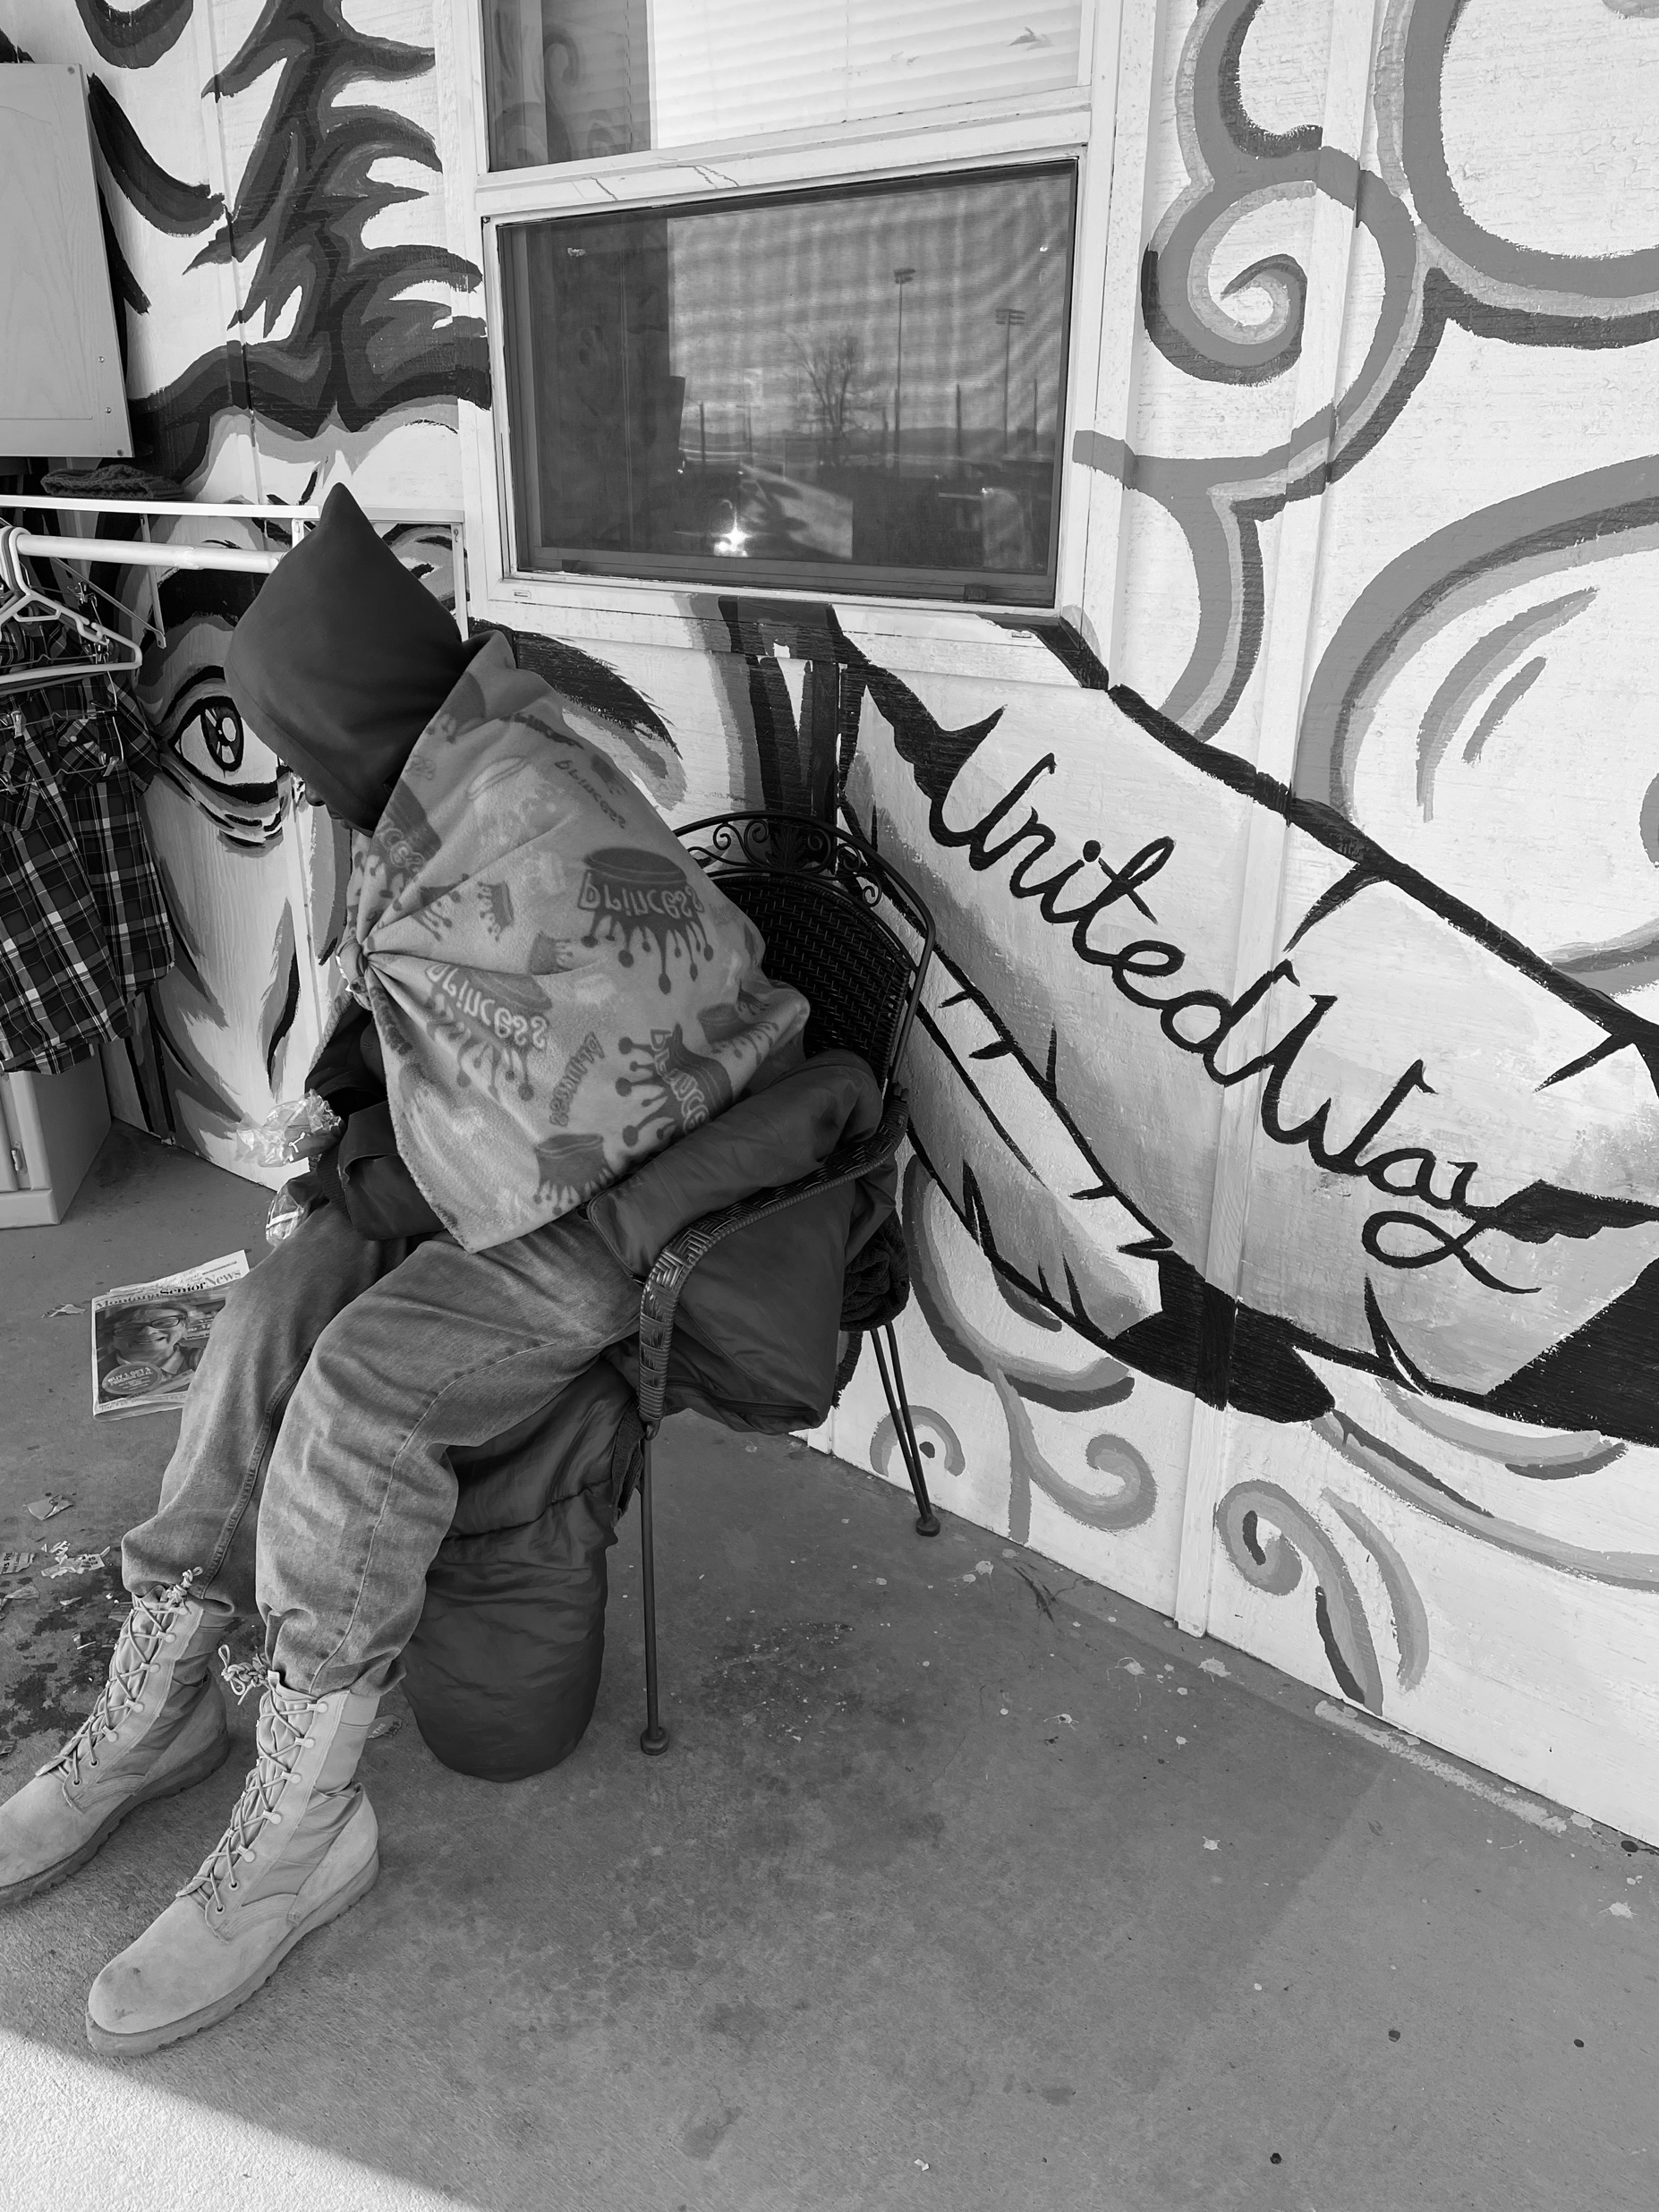
Successes
Formation of Action Teams
Housing Task Force Mobilized
Identified Gaps in Services
Clarified Goals with Data
Increased Awareness
ADD PICTURE OR DELETE

Slide 12
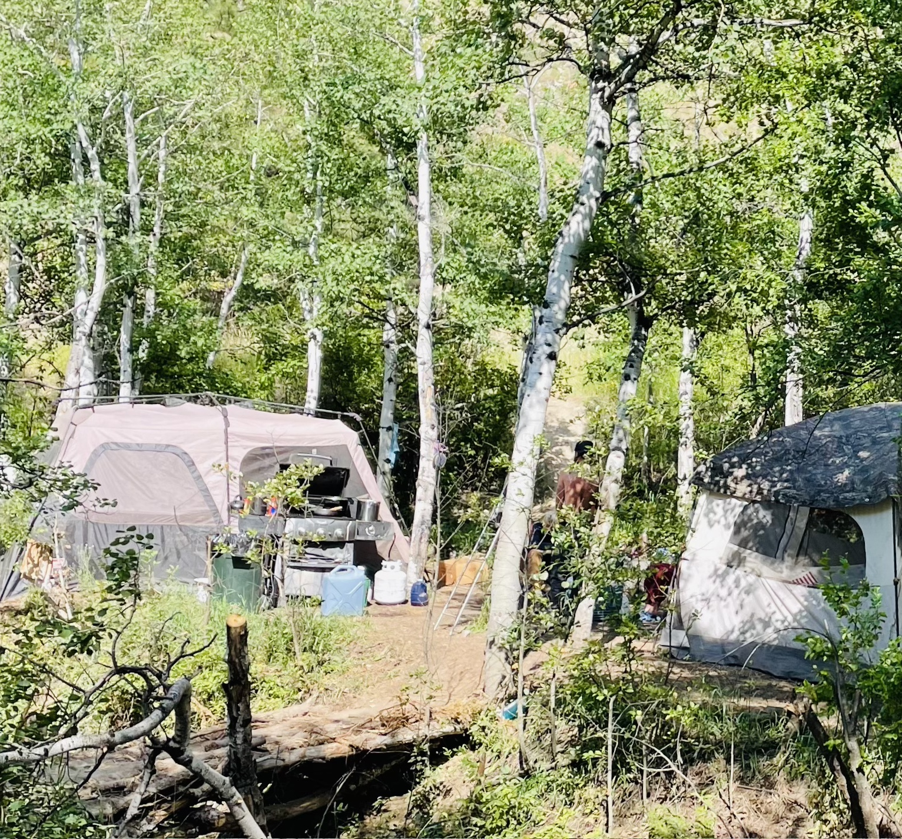
Challenges/Barriers
Lack of Housing
Funding
NIMBYism
Data Process Alignment
Lack of Housing

Slide 13
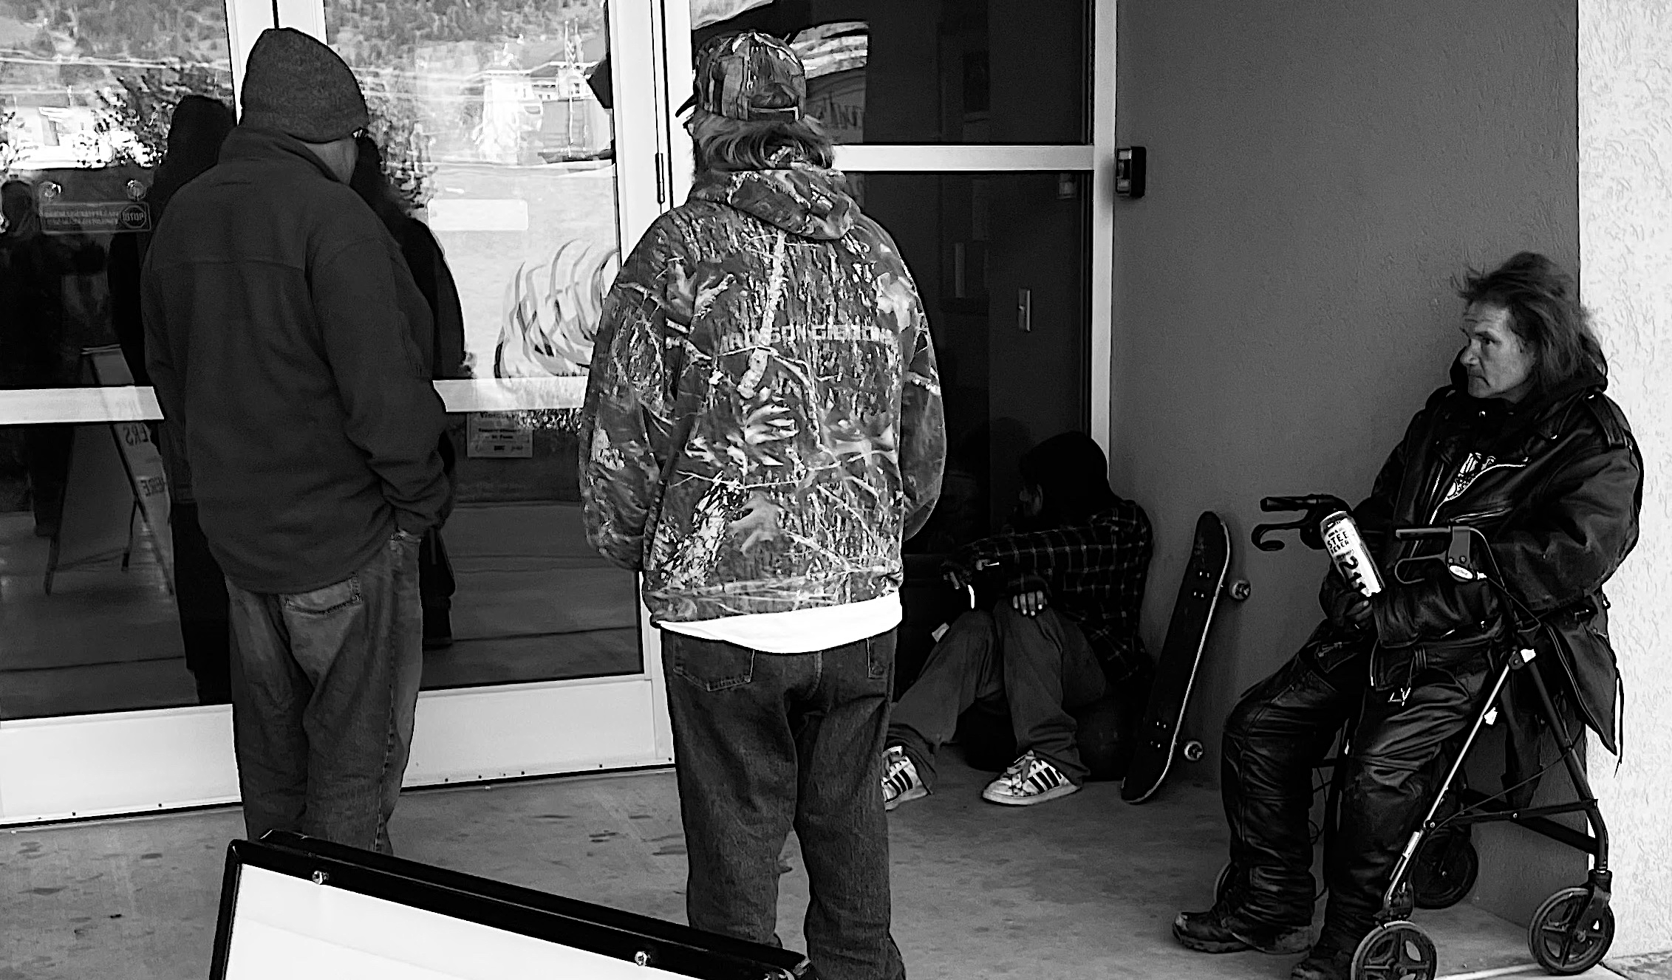
Year 2 Next Steps
Establish Clear goals for Action Teams
Establish Clear goals for Task Force
Improved Client data Sharing via HMIS
Create Emergency Shelter Site
Additional Staffing for Housing First

Slide 14
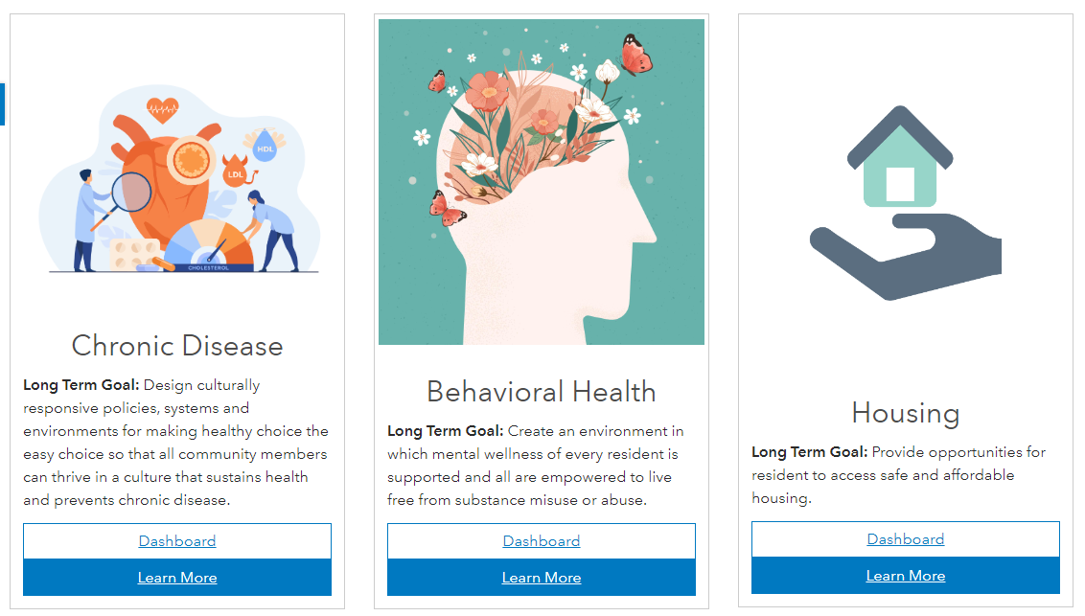
https://lcph-chip-helenamtmaps.hub.arcgis.com/

Slide 15
THANK YOU
For more information, contact: Chronic Disease: Sarah Sandau, ssandau@lccountymt.gov, 406-457-8960
Behavioral Health: Jess Hegstrom, jhegstrom@lccountymt.gov, 406-457-8970
Jolene Jennings, jjennings@lccountymt.gov, 406-457-8957
Housing:
Jeff Buscher, jeff@unitedwaylca.org, 406-442-4360

